Slide 1

Pay-Per-Click Advertising

Slide 2
What is Pay-Per-Click
According to MarketingTerms.com..
“Pay-Per-Click is an online advertising payment model in which payment is based solely on qualifying click-throughs.”
What Is PPC? Learn the Basics of Pay-Per-Click (PPC) Marketing [PPC U] (wordstream.com)

Slide 3
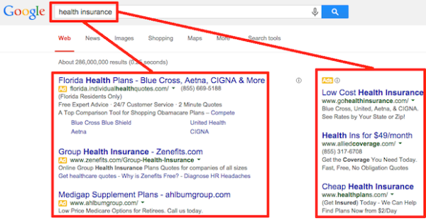
Example

Slide 4
PPC is an auction based system where various advertisers place bids to target and reach users online.
Whether you are looking to find users from paid search or from display advertisements, businesses of an size can leverage this channel to reach interested prospects.

Slide 5
PPC Campaign
Behind every successful PPC campaign lies a catchy ad that can attract the attention of online users. Advertisers focus on the following aspects while creating an online ad:
Research for effective keywords related to a product or a service
Choose the right keywords
Group the keywords relevantly
Arrange the keywords to create an advertise

Slide 6
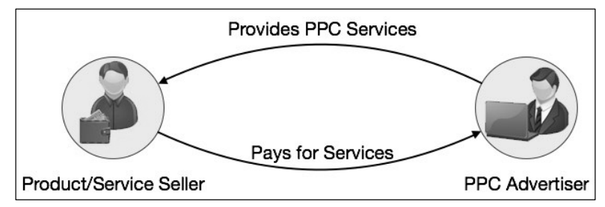
Entities
Product or Service Seller
PPC Advertiser
Landing Page Provider
Landing Page
Viewer or the Visitor

Slide 7
How Does it Work?
Bid on relevant keywords
Advertising engine displays your text ad on their results page or network of web sites
You only pay when people click
The Ultimate Guide to PPC Marketing (Pay-Per-Click) | PPC Hero
Notes:
You define the keywords and the ad engine displays your text or graphic ad among others under the sponsored links in search results or on contextual ad pages.

Slide 8
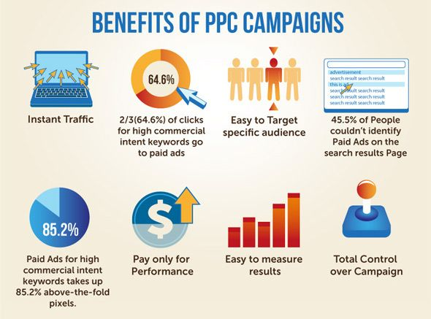
Why Advertise?

Slide 9
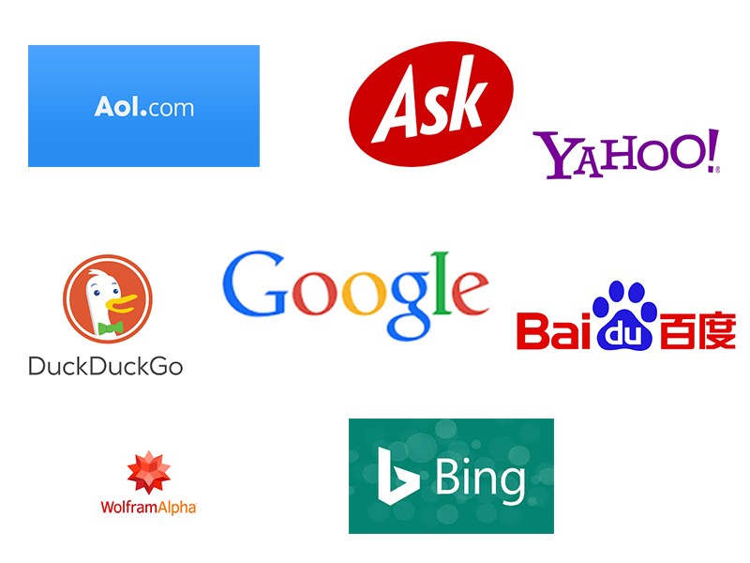
Who Are the Major Players?

Slide 10
Google
Keyword Targeted CPC (Cost Per Click)
More Clicks, Better Results
You set max per keyword and budget
Track Results – Conversion Tracker
Ads appear on Google.com
Google content network via Adsense program

Slide 11
Yahoo Sponsored Search (Formerly Overture)
Bid on keywords (auction format)
Highest bidder gets highest placement on the page
Yahoo, Bing, Altavista, CNN, Infospace
Yahoo Publishers Network Content Match (Beta)– Like Google Adsense

Slide 12
Bing
Step 1: Create a Bing Ads account. Go to the Bing Ads website and click on the Sign up now button in the top right corner. ...
Step 2: Import your Google Ads campaign (optional) At this point, you'll have two options: ...
Step 3: Research the best keywords. ...
Step 4: Create your first campaign.

Slide 13
Bing Vs Google
Google Ads, is comprised of two advertising networks:
The Search Network: Advertisers create text ads to appear on the search engine results page (SERP), example below
The Display Network: Advertisers create display ads to appear on a vast number of websites across the internet

Slide 14
Bing Vs Google
Bing, which is owned by Microsoft, has three search engines —
Bing, Yahoo, and AOL
When you advertise on one platform, your ad is actually seen on all three. This opens up campaigns to searchers across all Bing, Yahoo, and AOL owned and operated sites, as well as various partner sites
https://instapage.com/blog/bing-ads-vs-google-ads

